Slide 1
Android Programming Mobile Development
Dr Ian Drumm

Slide 2
Sensors
Aims:
Sensors
Learning Outcomes:
Utilising the SensorManager class
Handling Sensor Events
Sub classing a View to display sensor values

Slide 3
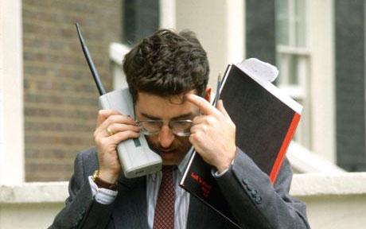
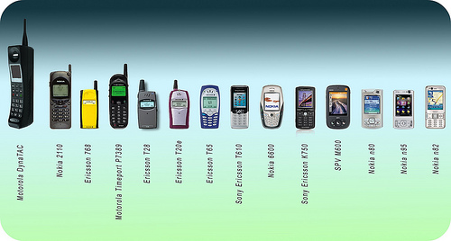
Early Mobile Phones
Screen Real-estate
Latency
Standards

Slide 4
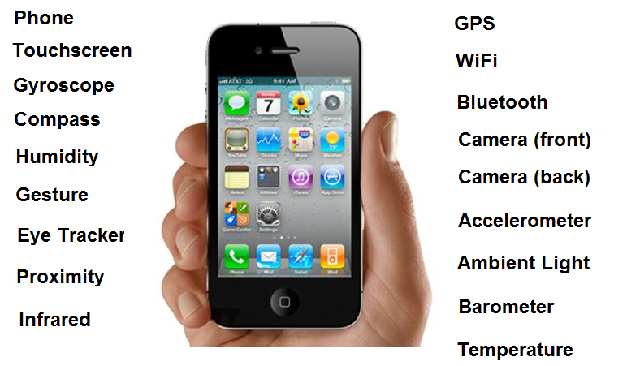
The Smart Phone

Slide 5
Motion Sensors
measure acceleration forces
and rotational forces
Environmental Sensors
temperature, pressure, light, etc
Position Sensors
the physical position of a device

Slide 6
The Android Sensor Framework
SensorManager
This class lets you access the device's sensors
Sensor
This class represents the sensor
SensorEventListener
The interface used for receiving notifications from the SensorManager when sensor values have changed
SensorEvent
This class represents the sensor event

Slide 7
Sensor Manager
SensorManager lets you access the device's sensors.
Get an instance by calling Context.getSystemService() with the argument SENSOR_SERVICE.
SensorManager s;
s= (SensorManager)getSystemService(SENSOR_SERVICE);

Slide 8
List of sensors
Supported by your device
TextView tv = (TextView)findViewById(R.id.textView);
List<Sensor> list = s.getSensorList(Sensor.TYPE_ALL);
for(Sensor sensor: list)
tv.append(sensor.getName()+"\n");

Slide 9
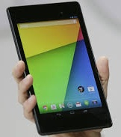
Nexus Sensors
MPL Accelerometer
AKM Magnetic Field
Orientation
Light On Ambient Light Sensor
MPL Gyroscope
Gravity
Linear Acceleration
Rotation Vector
Significant Motion
Game Rotation Vector
Notes:
MPL Motion Processing Library
AKM - Asahi Kasei Microdevices

Slide 10
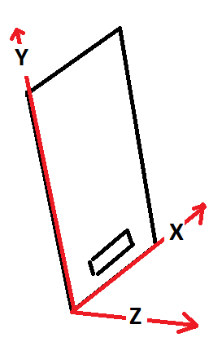

Accelerometer
Relates to force on device F=ma
X, Y, Z in ms⁻²
Acceleration due to gravity when device upright (0, 9.8, 0)
At other orientations the vector changes, so gives orientation
Newton’s third law, for every action there’s an equal and opposite reaction … induced force

Slide 11
Software-based Sensors
These are virtual / synthetic sensors, i.e. not direct from hardware. For example…
Gravity – removes motion acceleration from results
Linear Acceleration – removes gravity from the results

Slide 12
Sensor
Class representing a sensor.
Sensor acc;
acc = s.getDefaultSensor(Sensor.TYPE_ACCELEROMETER);

Slide 13
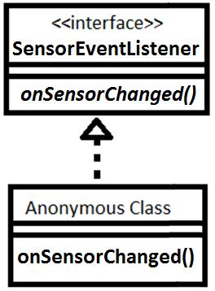
Sensor Interaction
Add to your activity class as a field a realisation of the ‘SensorEventListener’ interface.
So define a callback to handle sensor events.

Slide 14
Handling Sensor Events
Define and instantiate an anonymous class that’s a realisation of the SensorEventListener interface
SensorEventListener listener = new SensorEventListener() {
@Override
public void onSensorChanged(SensorEvent event) {
// some code
}
}

Slide 15
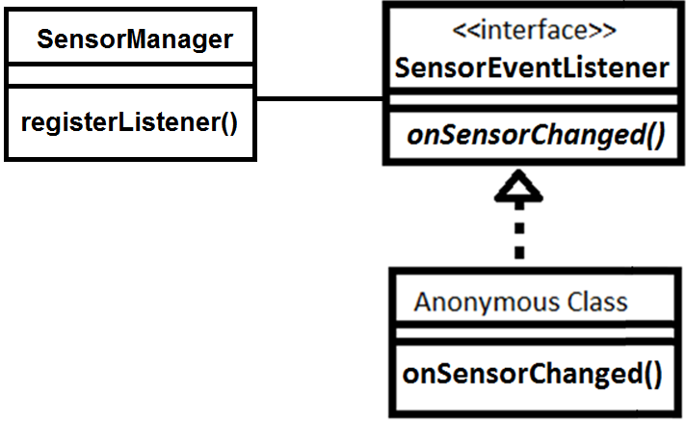
Associate Sensor Manager with Listener
Register Listener
Can unregister
Save batteries if in
onPause() & onResume()
s.registerListener(
listener, acc, SensorManager.SENSOR_DELAY_NORMAL
);

Slide 16
Handling Sensor Events
Parsing sensor events in onSensorChanged()
if (event.sensor.getType()==Sensor.TYPE_ACCELEROMETER) {
float x = event.values[0];
float y = event.values[1];
float z = event.values[2];
// send values to user interface
}

Slide 17
Sub classing a View
Can use a canvas of a custom view to display sensor values or control graphics
Get reference to MyView’s instance and pass sensor values from a fragment
public class MyView extends View {
@Override
protected void onDraw(Canvas canvas) {
super.onDraw(canvas);
canvas.drawText("Hello", x, y, paint);
}
}

Slide 18
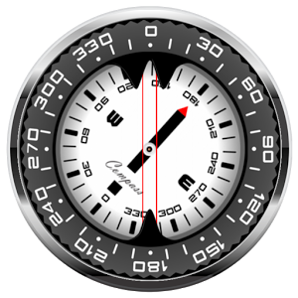
Magnetic Field
The built in compass
Gives ambient geomagnetic field
x, y and z in microteslas.

Slide 19
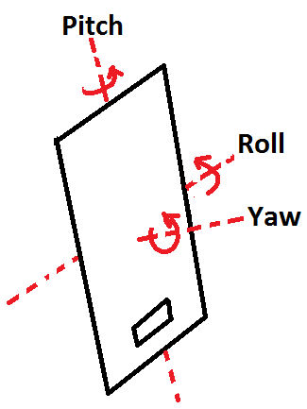
Orientation / Rotation
Orientation (deprecated)
Euler angles pitch, roll, yaw
I.e. rotations about x, y and z
Problem with Gimble lock
Rotation
Can get rotation vector as quaternion [w,x,y,z]
(a vector x,y,z and a rotation w about it)

Slide 20
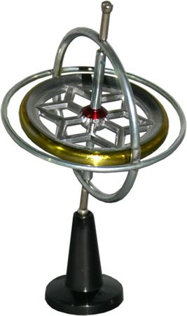
Gyroscope
Gives rate of rotations
around x, y, z
Pitch, Roll, Yaw
in rads⁻¹
Values zero when device
stationary.

Slide 21

Light sensor
Light sensor on device
In lx units (lumens per square meter)
Proximity sensors are often software sensors that use this hardware sensor
(can give phone position when calling)

Slide 22
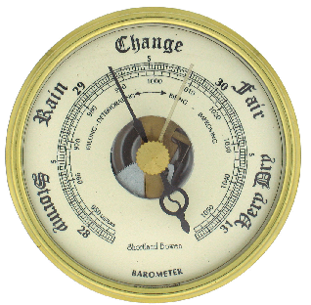
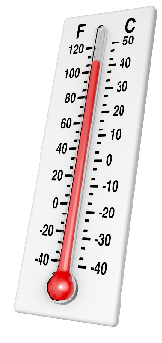
Other environment sensors
Pressure in hPa
(1 hectopascal Pascal ≡ 100 Pascals)
Ambient Temperature in Celsius
Humidity as %

Slide 23
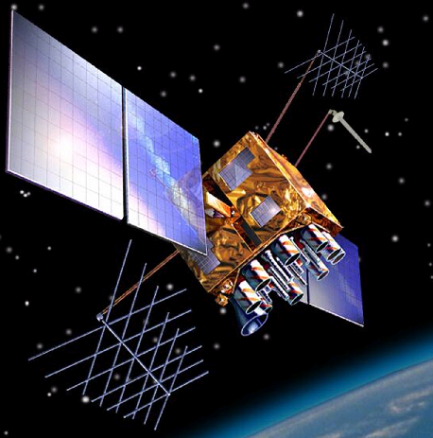
GPS: Not part of the sensor framework
Not SensorManager, use’s LocationManager
LocationManager locationManager
=(LocationManager)getSystemService(Context.LOCATION_SERVICE);
criteria = new Criteria();
provider = locationManager.getBestProvider(criteria, false);
location = locationManager.getLastKnownLocation(provider);

Slide 24
GPS
LocationListener listener = new LocationListener() {
public void onLocationChanged(Location location) {
lat = (int) (location.getLatitude());
lng = (int) (location.getLongitude());
}
}
locationManager.requestLocationUpdates(provider, dTime, dDist, listener);
}

